Slide 1
Booting from hard disk…
Starting Windos 98…
Start now

Slide 2


Slide 6
Welcome to Windos 98!
Welcome to Windos 98.
Close the window to start the welcome tour!

Slide 7
Welcome!
Welcome to Windos 98!
This version is improved and looks like windows 7!
Close to proceed

Slide 8
Welcome!
Please enter your username:
username
>

Slide 9
Welcome!
Please set a password to use the computer with:
>

Slide 10
Security alert
Setting the password to a blank one is not recommended. Please close the window to go back and press proceed to ignore this window

Slide 11
Welcome!
Please wait as we setup the system…
100% complete

Slide 12
Welcome!
Please close the window.
Setup has complete.

Slide 13
update
Please close the window to install the updates necessary to your system.
You need an internet connection to proceed.

Slide 14


Slide 15
updates
Have been completed.
Please close and logon!

Slide 16
logon
Please press sign in, Username!
Sign in

Slide 17
What’s new:
Revamped entire OS
Added welcome tour
Transferred programs to this build
Added computer [no access to C:\ until it is indexed fully]
Added all apps
Revamped power menu
Upgraded to Internet Explorer 22.5!
Windos 98
Alpha 1 release 2
for test purposes only

Slide 18
clippy.exe is not responding
Shortcuts:
Computer
All Apps
Power…
IE225

Slide 19

Internet Explorer 22.5
Reconnect here

Slide 20
Internet Explorer 22.5
Reconnecting. ..
complete

Slide 21
Internet Explorer 22.5; connected; DNS 1.1.1.2; IP address 112.12.12.345; connection speed is 10mbps; up to date browser;
DNS protocol is HTTPS; internet is secured by TSL encryption; cookies enabled; 1000 cookies stored in browser; this site uses 10 cookies; Internet Explorer was made by M1cr0$0ft in 2020. the successor of 3dg3.
Welcome to the Internet!
Please select one of these sites:
No sites available

Slide 22
computer
No readable disks inserted
Please update to see if C:\ Is added!

Slide 23


All apps
IE22.5
Email 2.02

Slide 24
Email client
V2. 02
For Windos 98
© 2020 M1cr0$0ft c0rp.

Slide 25
Email client v2.01 - inbox
It is empty! :)

Slide 26
Power off
Power off
Reboot
Sign out
Sleep
Crash system

Slide 27
Crash system
Click outside of window to cancel.
Close window to accept

Slide 28
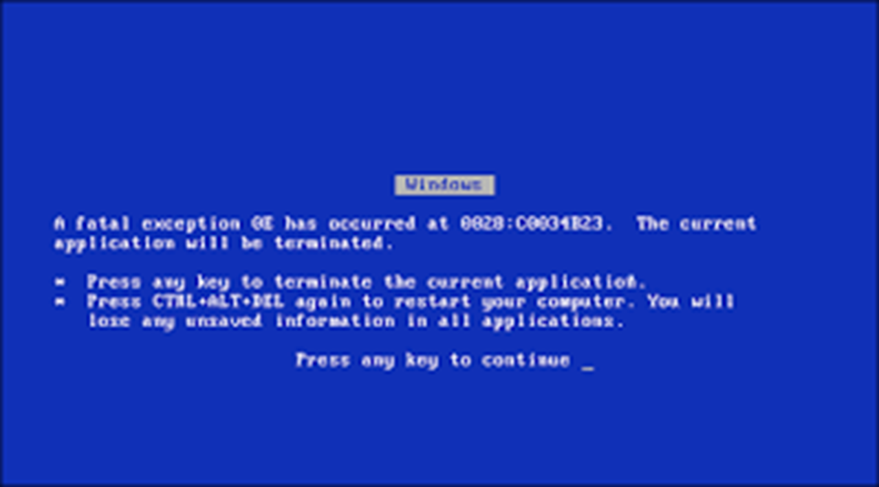

Slide 29
It is now safe to turn off this PC
Press ESC to turn off
reboot

